Slide 1
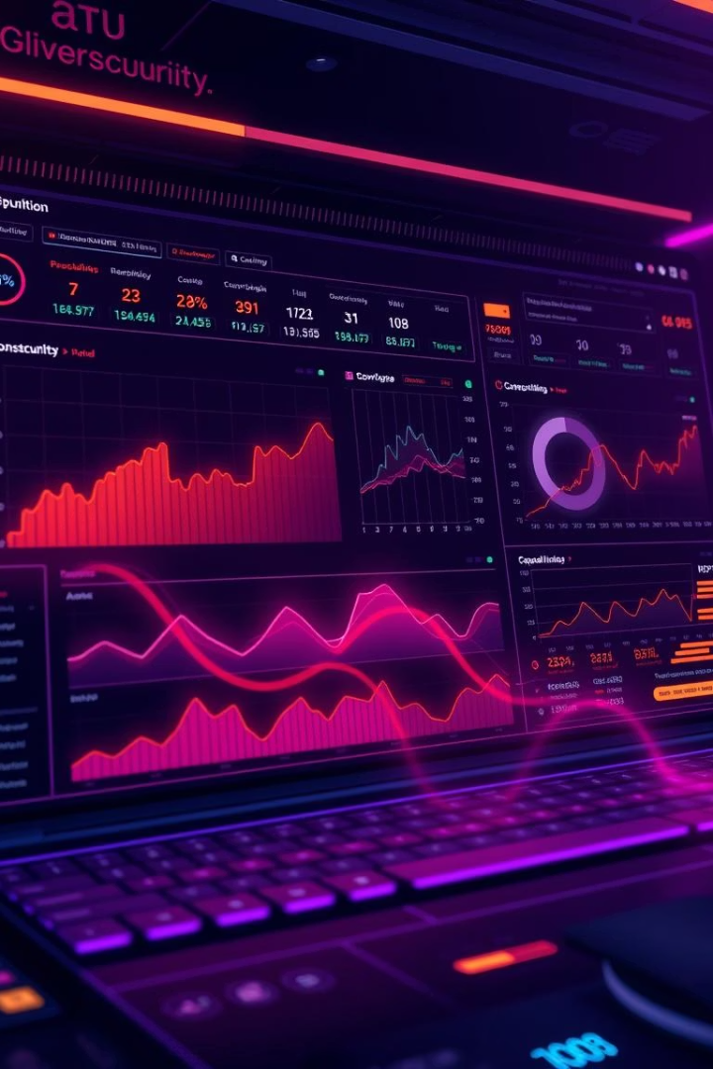
AI-Powered Phishing & Threat Intelligence Detection System
This project merges cybersecurity expertise with AI and data science innovations.
Our team members include [Your Name], [Friend A], and [Friend B].

Slide 2

The Problem
Widespread Breaches
Advanced Attacks
Phishing drives over 90% of global data breaches.
Attackers leverage AI and psychology to evade filters.
Solution Gaps
Current tools lack real-time AI adaptation and flexibility.

Slide 3
Our Solution
Real-Time Detection
AI Classification
Sandbox Simulation
Threat Scoring
Identifies phishing emails, links, and files instantly.
Uses BERT-based NLP for intelligent threat classification.
Simulates malicious activity safely and securely.
Evaluates severity and confidence with a scoring engine.

Slide 4

Technology Stack
Core Frameworks
Python, FastAPI, HuggingFace Transformers, scikit-learn
Cloud Deployment
Optional AWS and GCP deployment for scalability
Datasets
PhishTank, SpamAssassin, Kaggle Email Dataset
Security
Secure APIs and containerized sandbox for threat simulation

Slide 5





System Architecture
Input
Email or URL received
Preprocessing
Clean and prepare data
NLP Model
BERT-based classification
Threat Scoring
Evaluate risk level
Output
Phishing or benign verdict
The modular pipeline enables integration with browsers and SOC tools.

Slide 6





Key Capabilities
Sandbox Simulation
Real-Time Detection
Isolates threats to observe behavior securely.
2
Transformer NLP algorithms analyze incoming data instantly.
1
Modular APIs
Flexible design for diverse integration needs.
3
Lightweight Deployment
5
Optimized for enterprise and education environments.
Adaptive Training
4
Continuous learning with new datasets.

Slide 7
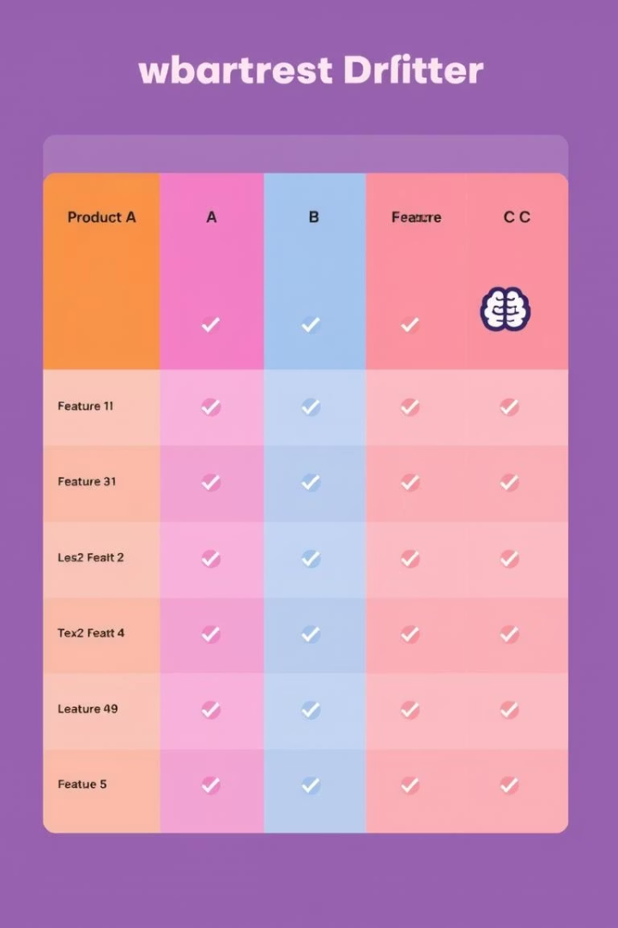
Competitor Analysis
Feature
Our Solution
Google Safe Browsing
Microsoft Defender
VirusTotal
Real-Time Detection
✅
✅
✅
✅
AI-Based/NLP
✅
❌
✅
❌
Sandbox Simulation
✅
❌
❌
✅
Dataset Flexibility
✅
❌
❌
❌
Open Source / API
✅
❌
❌
Partial
Our system excels in transparency and modern AI integration.

Slide 8

Future Scope
Browser Extension
Real-time phishing alerts in Chrome browser.
Email Gateway Plugin
Enterprise-grade protection integrated with mail servers.
Phishing Simulation Trainer
Tools to enhance cybersecurity awareness education.
SOC and SIEM Integration
Smart response capabilities for security operations centers.

Slide 9
Business Model & Social Impact
Business Model
Social Impact
Freemium for students and researchers
Reduce phishing and cybercrime
Premium APIs for enterprises
Support cybersecurity education
Custom environments for training
Partner with schools, NGOs, journalists
Monetization of browser plugin

Slide 10

Thank You!
We welcome your suggestions, questions, and feedback.

